Slide 1
Fundamental Concepts of OOP

Slide 2
Encapsulation
OOP's innovation that made the paradigm a solution to the issues of state is its mechanism to construct boundaries wherever you want.

Slide 3
Encapsulation
Encapsulation, when done correctly, makes your system approach a more accurate simulation of the real world.

Slide 4
Encapsulation
The more you encapsulate related data and methods, the more you'll create cohesive classes that have definite and indivisible purpose.

Slide 5
Encapsulation
You should encapsulate what varies, meaning, things that always change should be encapsulated deep into the structure of your code.

Slide 6
Which implementation is better?
Consider a system that calculates tax by multiplying amounts with a tax rate, which is the best implementation for tax calculation
A global variable called TAX_RATE
Hard code the tax value for every instance of use.
Implement some function called taxedPrice() which calculates tax

Slide 7
Encapsulation
Encapsulating what varies helps with maintainability since the changing a isolated data or behavior will have less effect.

Slide 8
Encapsulation
Encapsulation means both attributes and behaviors.
Concrete objects should be given the responsibility of implementing their own behavior.
Notes:
This means that a method that describes the behavior of a certain class should belong to that class.

Slide 9
Abstraction
An abstraction in computer science is basically a model of computation that is free from its implementation.
In the same way that functional programming creates abstractions of mathematical functions by writing functions/lambdas without side effects, OOP creates abstractions of objects using interfaces that don't specify the exact implementation of an object.

Slide 10
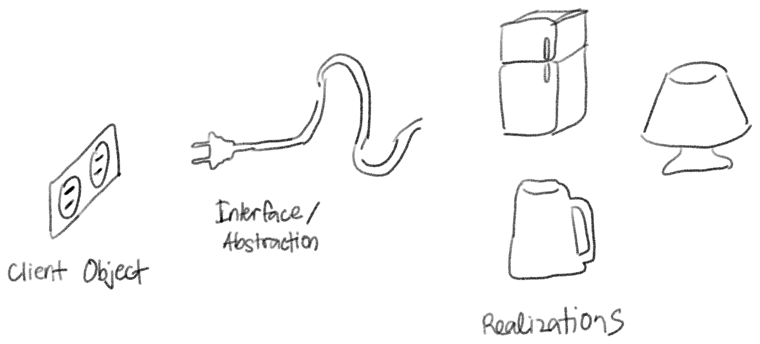
Abstraction
Notes:
This means that a method that describes the behavior of a certain class should belong to that class.

Slide 11
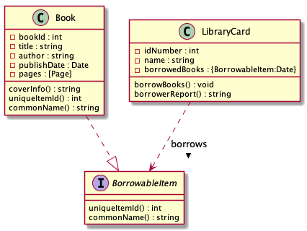
Abstraction
Notes:
This means that a method that describes the behavior of a certain class should belong to that class.

Slide 12
Abstraction
The interface BorrowableItem is an abstract representation of something from the library that can be borrowed.
Notes:
This means that a method that describes the behavior of a certain class should belong to that class.

Slide 13
Abstraction
Because a Book is a BorrowableItem, it must also behave based on the specifications of a BorrowableItem. Meaning it must contain the methods uniqueItemId() and commonName()
Notes:
This means that a method that describes the behavior of a certain class should belong to that class.

Slide 14
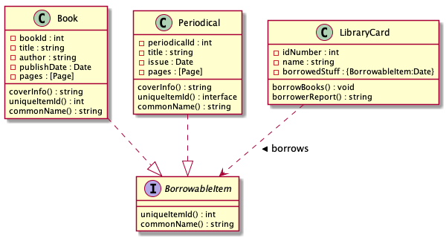
Abstraction
Notes:
This means that a method that describes the behavior of a certain class should belong to that class.

Slide 15
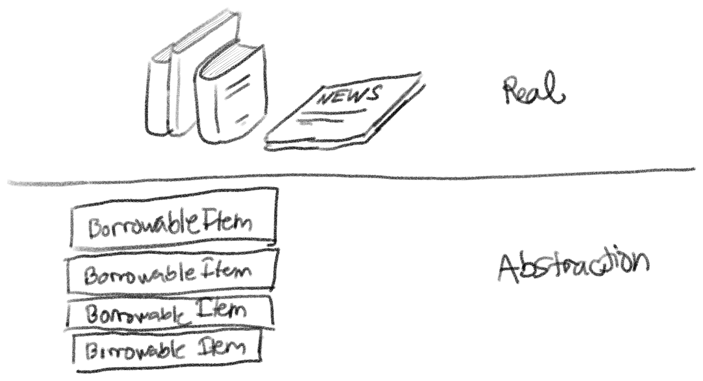
Abstraction
Notes:
This means that a method that describes the behavior of a certain class should belong to that class.

Slide 16
Inheritance
Inheritance is the concept in which the definition of a class is derived from another class.
An existing class, called the super class (also called the base class or the parent class) passes all visible attributes and methods to a sub class (also called the derived class or the child class).

Slide 17
Inheritance
Encapsulation means both attributes and behaviors.
Concrete objects should be given the responsibility of implementing their own behavior.

Slide 18
Inheritance
The concept of inheritance is also a representation of the real world. You use inheritance to represent generalizations and specializations.
A super class is a generalization of a sub class and a sub class is a specialization of a super class.

Slide 19
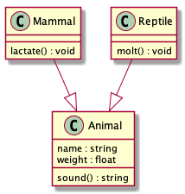

Slide 20
Inheritance
In this example the supertype animal is a generalization of the subtype mammal.

Slide 21
Inheritance
Although it isn’t shown, Mammal will also have the attributes name and weight and the method sound() since it inherits these from the parent class.

Slide 22
Inheritance
Mammal has a method of its own called lactate() which it doesnt share with animal.

Slide 23
Inheritance
A subclass can also be a super class for another class.
This is used to represent specializations of specializations.

Slide 24
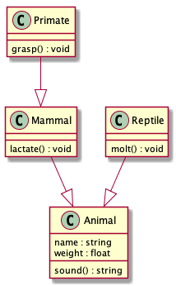

Slide 25
Polymorphism
Polymorphism literally means multiple forms. One of the core philosophy of OOP allows object instances to exist in multiple forms.
What this means code-wise is that the types of object instances can be decided during runtime.

Slide 26
Inheritance
Mammal has a method of its own called lactate() which it doesn’t share with animal.

Slide 27
Compile-time polymorphism
There’s also another type of polymorphism that is not necessarily shared by all OOP languages, compile-time polymorphism.

Slide 28
Compile-time polymorphism
This is basically the feature where multiple functions can have the same name as long as they have different parameter type signatures.
This is also known as method overloading.

Slide 29
Run-time polymorphism
Run-time polymorphism is basically achieved using specialization and realization relationships between objects.

Slide 31
Run-time polymorphism
An object instantiated to be of type Primate is also an instance of an Animal because a primate is just a specialization of an animal.

Slide 32
Run-time polymorphism
This reflects how the real world works because a primate is indeed an animal

Slide 33
Run-time polymorphism
On realization relationships like a Book and a BorrowableItem, the same is also true, because a book is also something that can be borrowed.

Slide 34
Run-time polymorphism
Realization and specialization relationships guarantee that you can interact with a sub type as its super type and you can interact with concrete class as its abstraction.

